Slide 1
Air Quality Analyzer
It will analyze smoke, gases and temperature present in a certain reason.
Using this we can find Air pollution in an area like- in our house, in office, at public places etc.
If anybody is suffering from asthma, any allergic to certain type of environment then he/she will not go in that area.

Slide 2
Applications
Detect Air pollution from environment.
Domestic gas leakage detector.
Industrial Combustible gas detector.
Vehicle alcohol detector.
Temperature detector.
We can use this in hospitals, banks, schools, colleges, public places etc.
* It is portable. *

Slide 3
Used Sensors
MQ2-Air quality sensor
It detects domestic gas leakage, LPG, Propane, Methane and Hydrogen.
MQ3- Gas Sensor
It detects Smoke, Alcohol, Gasoline, Vapour.
Temperature Sensor
It detects the temperature.

Slide 4
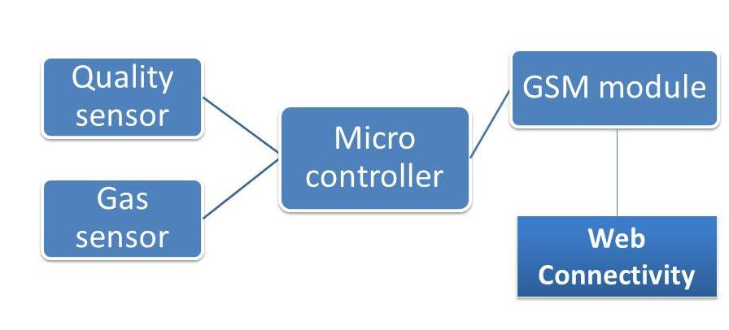
Block diagram

Slide 5
Thank You !!!!

